Slide 1



Intro to Data and Regex
15/11/2019 NLS
Lucia Michielin
Edinburgh University
L.Michielin@sms.ed.ac.uk

Slide 2
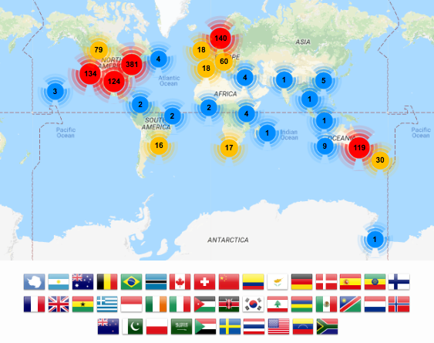



Foundational skills for researchers
Open source learning, “Train the trainers”
Basic lab skills for scientific computing; researchers can do more in less time and with less pain.
Basic concepts, skills and tools for working more effectively with data.
Software and data skills for people working in library- and information-related roles

Slide 3




The Carpentries: what is it?
Started by Greg Wilson in North America
The SSI was primary in spreading to UK/Europe
Teach basic computing skills to students and staff
Started with Software Carpentries then …
Data Carpentries
Library Carpentries
HPC Carpentries
etc
Type of carpentry affects the curriculum taught

Slide 4

Edinburgh Carpentries
Edinburgh Carpentries is a local community of instructors and volunteers of The Carpentries at the University of Edinburgh. Our instructors are trained volunteers, who deliver workshops about introductory coding and coding best practices, specifically targeted at academics.
The Carpentries workshops are suitable for complete beginners.
We have a committee split in two groups:
- Steering group: with remit of giving strategic advice and possibly negotiating institutional support and looking at funding opportunities;
- Organising group: with hands on the operations.

Slide 5
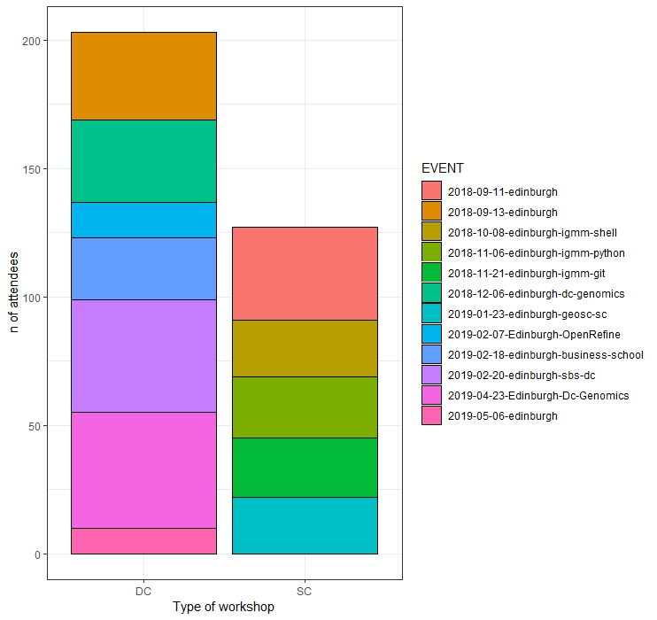
Edinburgh Carpentries
22 workshops took place so far plus this one starting today
13 Software Carpentries organised
9 Data Carpentries organised
More than 500 people attended so far

Slide 6
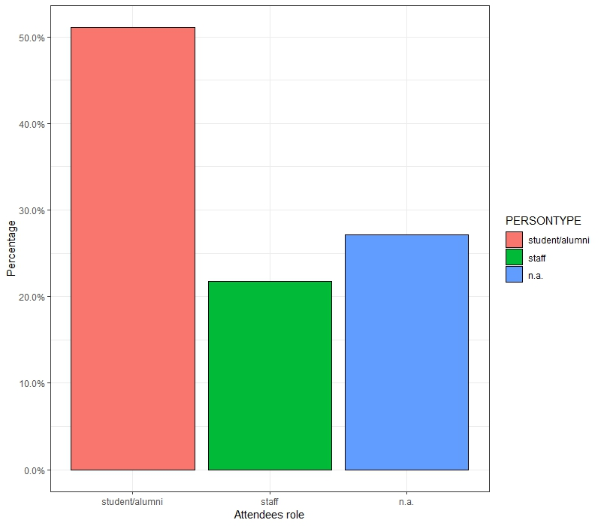
Edinburgh Carpentries
Just over 50% of the attendees are either student of alumni of the university (mostly PhD’s)
21% of the attendees are part of the University staff

Slide 7
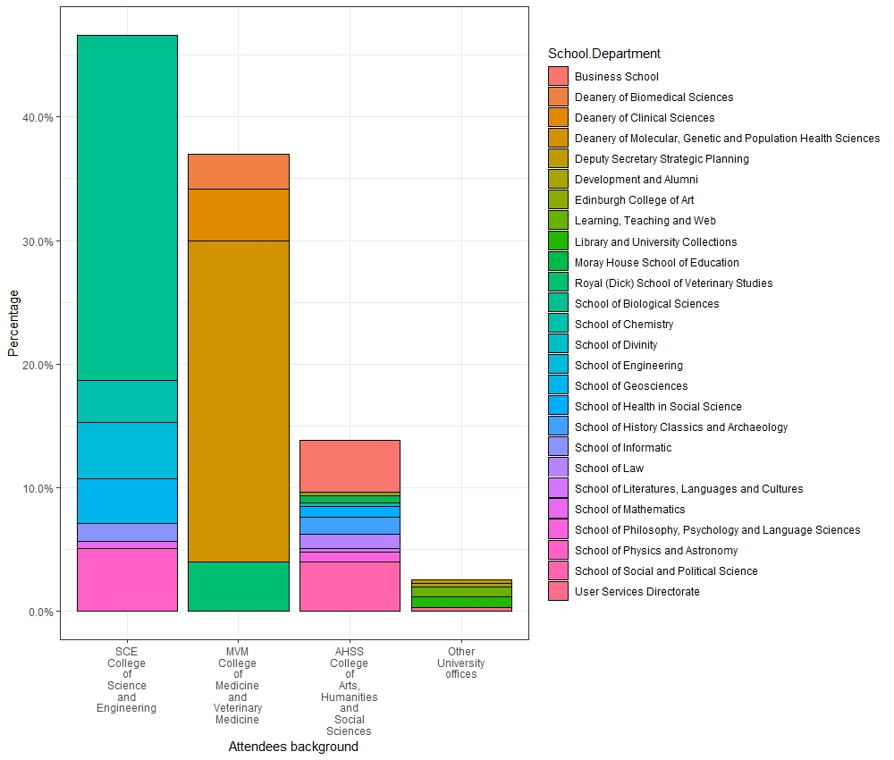
Edinburgh Carpentries:
The most represented Schools are those of Biological Sciences (28%) and the Deanery of Molecular, Genetic and Population Heath Sciences (26%)
The college more represented is that of SCE (College of Science and Engineer: 46.6%). MVM (College of Medicine and Veterinary medicine: 37%). AHSS (College of Arts Humanities and Social Sciences: 14%)

Slide 8


Library Carpentry at NLS
Instructors
Lucia Michielin, Justin Ho, Jennifer Daub, TBC
Surveys
pre-workshop & post-workshop
Please abide by our code of conduct!
Next Dates
13 December 2019 (9am-12.30pm);
7 February 2020 (9am-12.30pm);
20 March 2020 (time TBC);
17 April 2020 (1.30pm-5pm);
1 May 2020 (1.30pm-5pm)

Slide 9
Content of this workshop
Intro to data
Tidy data
OpenRefine
Shell intro
Intro to Python
Intro to R
https://edcarp.github.io/2019-11-15-edinburgh-library-carpentry/

Slide 10
Why a «Humanist» shall be bother in learning all of this?
automate repetitive, boring, error-prone tasks
create, maintain and analyze sustainable and reusable data
work effectively with IT and systems colleagues
better understand the use of software in research
and much more...

Slide 11

Before starting …
Who are we?
Why are we here?

Slide 12
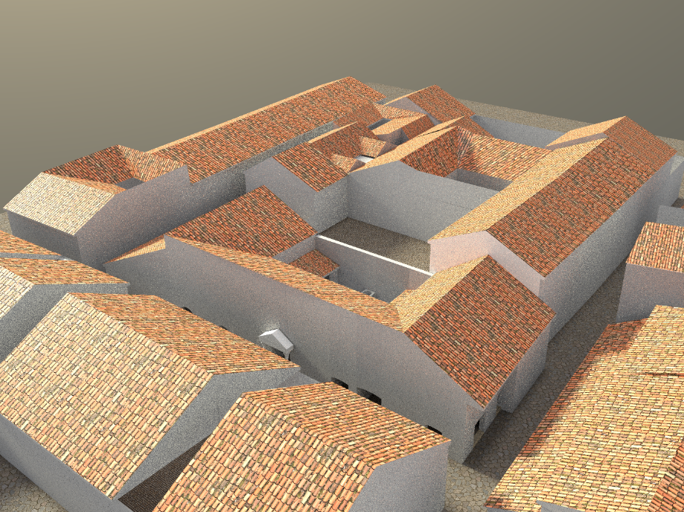
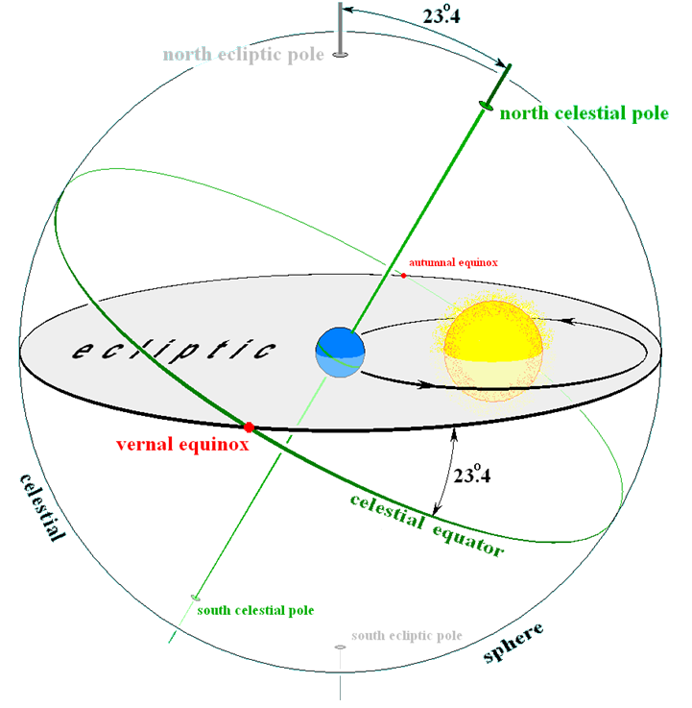
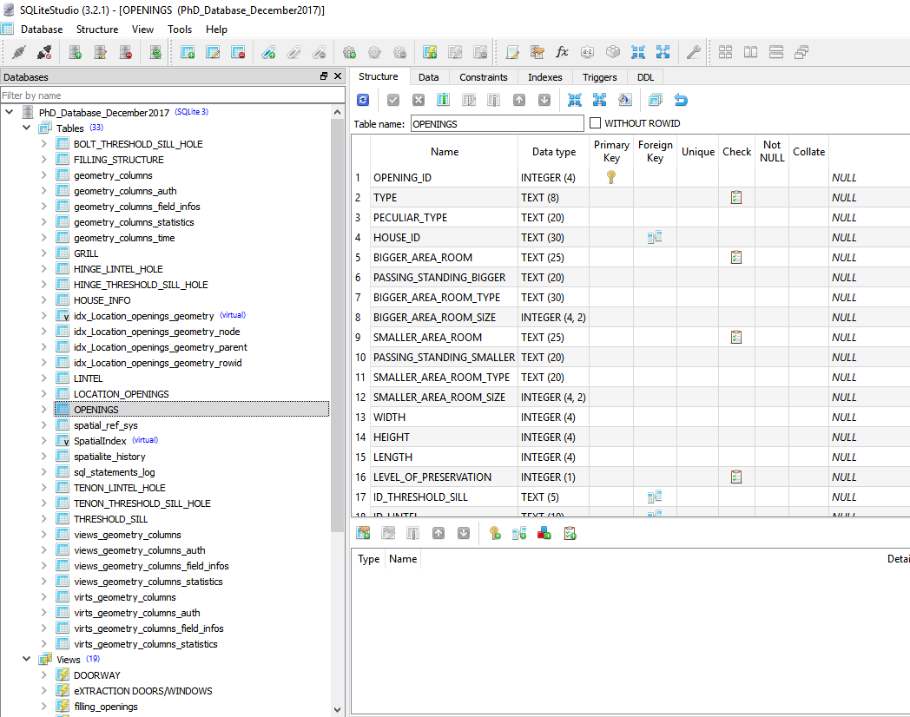
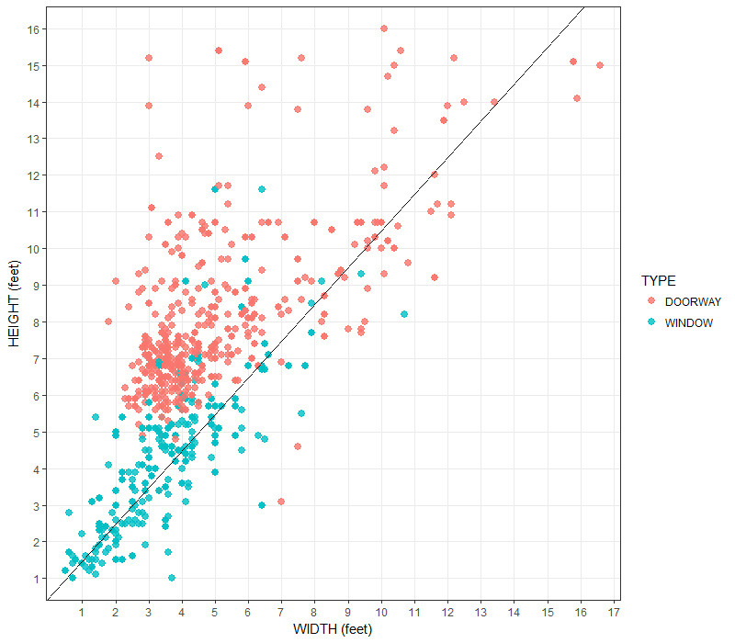

Before starting …
Who am I
I obtained a Phd in Classic from UEd
No informatic/scientific University background

Slide 13



Some practical info
Coffe break
Restrooms
Stickers
Collaborative Document (https://pad.carpentries.org/2019-11-15-edinburgh-library-carpentry)

Slide 14
Plan of today
1. Introduction
2. Jargon Busting
3. Regular Expressions
4. Matching and Extracting
5. Additional Exercises

Slide 15
Libraries are guided by the needs of their communities…
1. Introduction
Surveys point to an increasing need from researchers for data & software skills
Researchers do not receive the training they need in software best practices
Many universities are integrating data science into the curriculum
Industry is looking to hire more data savvy candidates
Early career researchers are looking for career advancement opportunities

Slide 16
Unmet needs According to Barone L, Williams J and Micklos D. Unmet Needs for Analyzing Biological Big Data: A Survey of 704 NSF Principal Investigators (2017):
1. Introduction
Nearly 90% of Biological Sciences Directorate PIs said they are currently/will soon be analyzing large data sets
Majority of said their institutions are not meeting 9 of 13 needs
Training on integration of multiple data types (89%), on data management and metadata (78%), and on scaling analysis to cloud/High-Performance-Computer (71%) were the 3 greatest unmet needs
Data storage and High-Performance-Computer ranked lowest on their list of unmet needs
The problem is the growing gap between the accumulation of big data—and researchers’ knowledge about how to use it effectively

Slide 17
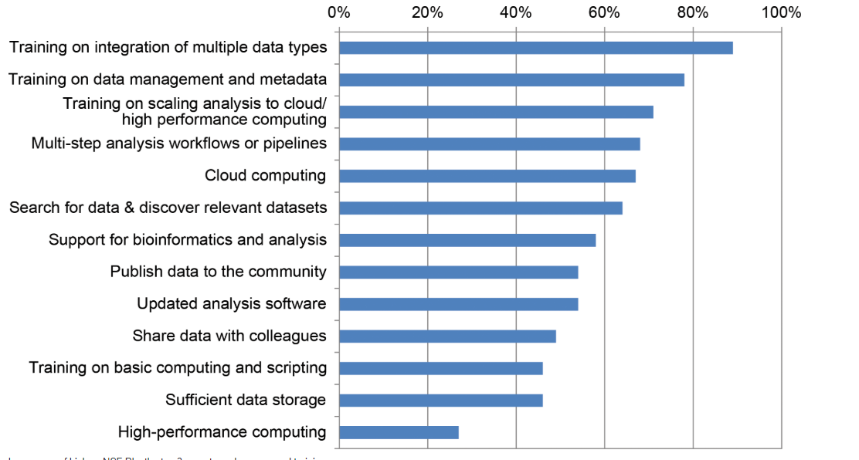
1. Introduction

Slide 18
Why coming to a Library Carpentry? Library Carpentry core objectives Library Carpentry workshops teach people working in library- and information-related roles how to:
1. Introduction
Cut through the jargon terms and phrases of software development and data science and apply concepts from these fields in library tasks;
Identify and use best practices in data structures;
Learn how to programmatically transform and map data from one form to another;
Work effectively with researchers, IT, and systems colleagues;
Automate repetitive, error prone tasks.

Slide 19
What we are going to see today?
1. Introduction
This workshop allows participants to explore concepts or jargon around software development and data science. Additional it explores regular expressions or pattern matching to find, manage, and transform data and files.
Did any of you used a computational approach to data managing before? If so, using which tools?

Slide 20
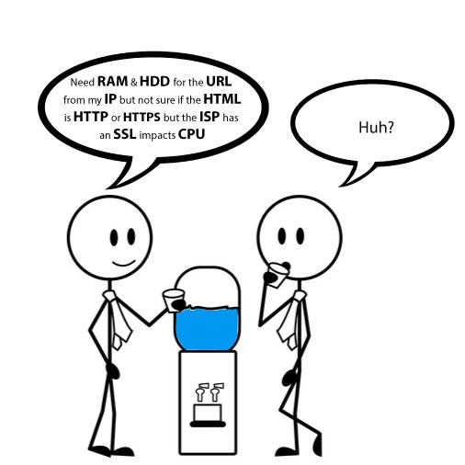
2. Jargon Busting
Questions
What terms, phrases, or ideas around code or software development have you come across and feel you should know better? Have you ever heard the term regex?
Objectives
Explain terms, phrases, and concepts associated with software development in libraries.
Compare knowledge of these terms, phrases, and concepts.
Differentiate between these terms, phrases, and concepts.

Slide 21
2. Jargon Busting
Some external help:
https://techterms.com/category/technical
https://nnlm.gov/data/thesaurus
https://sidewaysdictionary.com/
STEP 1
Pair with a neighbor and decide who will take notes
Discuss the concept idea about the use of computers in your everyday work that heard, and you feel you shall understand better specifically in relation to using regular expressions
(3 Min)

Slide 22
2. Jargon Busting
STEP 2
Join up an other group and compare notes (4 to 6 people for each group)
Make a list of all the problematic terms, phrases, and ideas each pair produced. Retain duplicates.
Identify common words as a starting point - spend 10 minutes working together to try to explain what the terms, phrases, or ideas on your list mean. Note: use both each other and the internet as a resource.
Identify the terms your groups were able to explain as well as those you are still struggling with.
Each group then reports back on one issue resolved by their group and one issue not resolved by their group.

Slide 23
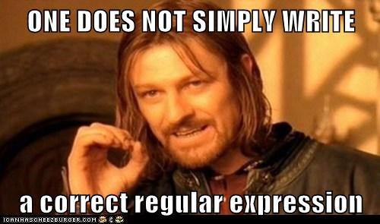
3. Regular Expressions
Questions
How can you imagine using regular expressions in your work?
Objectives
Use regular expressions in searches

Slide 24

3. Regular Expressions
Regular expressions
Regular expressions are a concept and an implementation used in many different programming environments for sophisticated pattern matching. They are an incredibly powerful tool that can amplify your capacity to find, manage, and transform data and files.
A regular expression, often abbreviated to regex, is a method of using a sequence of characters to define a search to match strings, i.e. “find and replace”-like operations. In computation, a ‘string’ is a contiguous sequence of symbols or values.
In library searches, we are most familiar with a small part of regular expressions known as the “wild card character,” but there are many more features to the complete regular expressions syntax.
Regular expressions will let you:
Match on types of characters (e.g. ‘upper case letters’, ‘digits’, ‘spaces’, etc.).
Match patterns that repeat any number of times.
Capture the parts of the original string that match your pattern.

Slide 25
3. Regular Expressions
Regular expressions rely on the use of literal characters and metacharacters.
A metacharacter is any American Standard Code for Information Interchange (ASCII) character that has a special meaning. By using metacharacters and possibly literal characters, you can construct a regex for finding strings or files that match a pattern rather than a specific string.
It is also important to be able to “escape” these metacharacters to use them for their normal, literal meaning. For example, the period . means “match any character”, but if you want to match a period then you will need to use «\» in front of it to signal to the regular expression processor that you want to use the period as a plain old period and not a metacharacter. That notation is called “escaping” the special character. The concept of “escaping” special characters is shared across a variety of computational settings, including markdown and Hypertext Markup Language (HTML).
For example, say your organization wants to change the way they display telephone numbers on their website by removing the parentheses around the area code. Rather than search for each specific phone number (that could take forever and be prone to error) or searching for every open parenthesis character (could also take forever and return many false-positives), you could search for the pattern of a phone number.

Slide 26
3. Regular Expressions
N.B.
Most regular expression implementations employ similar syntaxes and metacharacters (generally influenced by the regex syntax of a programming language called Perl), and they behave similarly for most pattern-matching in this lesson. But there are differences, often subtle, in each, so it’s always a good practice to read the application or language’s documentation whenever available, especially when you start using more advanced regex features. Some programs, notably many UNIX command line programs (for more on UNIX see our ‘Shell Lesson’), use an older regex standard (called ‘POSIX regular expressions’) which is less feature-rich and uses different metacharacters than Perl-influenced implementations. For the purposes of our lesson, you don’t need to worry too much about all this, but if you want to follow up on this see this detailed syntax comparison.
The regular expression would be to locate the same word spelled two different ways. For example the regular expression organi[sz]e matches both “organise” and “organize”. But it would also match reorganise, reorganize, organises, organizes, organised, organized, etc

Slide 27
3. Regular Expressions
Uses
Regexes are useful in a wide variety of text processing tasks, and more generally string processing, where the data need not be textual. Common applications include data validation, data scraping (especially web scraping), data wrangling, simple parsing, the production of syntax highlighting systems, and many other tasks.
Regular expressions are used in search engines, search and replace dialogs of word processors and text editors, in text processing utilities such as sed and AWK and in lexical analysis. Many programming languages provide regex capabilities either built-in or via libraries.

Slide 28
3. Regular Expressions
Learning common regex metacharacters
Square brackets can be used to define a list or range of characters to be found. So:
[ABC] matches A or B or C.
[A-Z] matches any upper case letter.
[A-Za-z] matches any upper or lower case letter.
[A-Za-z0-9] matches any upper or lower case letter or any digit.

Slide 29
3. Regular Expressions
Learning common regex metacharacters
. matches any character.
\d matches any single digit.
\w matches any part of word character (equivalent to [A-Za-z0-9]).
\s matches any space, tab, or newline.
\ used to escape the following character when that character is a special character. So, for example, a regular expression that found .com would be \.com because . is a special character that matches any character.
^ is an “anchor” which asserts the position at the start of the line. So what you put after the caret will only match if they are the first characters of a line. The caret is also known as a circumflex.
$ is an “anchor” which asserts the position at the end of the line. So what you put before it will only match if they are the last characters of a line.
\b asserts that the pattern must match at a word boundary. Putting this either side of a word stops the regular expression matching longer variants of words. So:
the regular expression mark will match not only mark but also find marking, market, unremarkable, and so on.
the regular expression \bword will match word, wordless, and wordlessly.
the regular expression comb\b will match comb and honeycomb but not combine.
the regular expression \brespect\b will match respect but not respectable or disrespectful.

Slide 30
3. Regular Expressions
Boolean "or"
A vertical bar separates alternatives. For example, gray|grey can match "gray" or "grey".
Grouping
Parentheses are used to define the scope and precedence of the operators (among other uses). For example, gray|grey and gr(a|e)y are equivalent patterns which both describe the set of "gray" or "grey".
Quantification
A quantifier after a token or group specifies how often that a preceding element is allowed to occur.
? The question mark indicates zero or one occurrences of the preceding element. For example, colou?r matches both "color" and "colour".
* The asterisk indicates zero or more occurrences of the preceding element. For example, ab*c matches "ac", "abc", "abbc", "abbbc", and so on.
+ The plus sign indicates one or more occurrences of the preceding element. For example, ab+c matches "abc", "abbc", "abbbc", and so on, but not "ac".

Slide 31
3. Regular Expressions
Other useful special characters are:
{min,} The preceding item is matched min or more times.
{min,max} The preceding item is matched at least min times, but not more than max times.
{VALUE} matches the preceding character the number of times defined by VALUE; ranges, say, 1-6, can be specified with the syntax {VALUE,VALUE}, e.g. \d{1,9} will match any number between one and nine digits in length.
/i renders an expression case-insensitive (equivalent to [A-Za-z]).

Slide 32
3. Regular Expressions
Example 1:
What will the regular expression ^[Oo]rgani.e\b match?
https://www.browserling.com/tools/text-from-regex
Solution
Any other string that starts a line, begins with a letter o in lower or capital case, proceeds with rgani, has any character in the 7th position, and ends with the letter e.

Slide 33
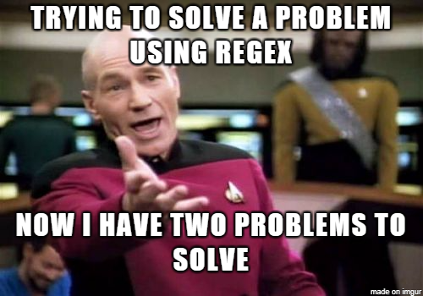
3. Regular Expressions
Example 2:
What will the regular expression ^[Oo]rgani.e\w*match?
https://www.browserling.com/tools/text-from-regex
Solution
Any other string that starts a line, begins with a letter o in lower or capital case, proceeds with rgani, has any character in the 7th position, follows with letter e and zero or more characters from the range [A-Za-z0-9].

Slide 34
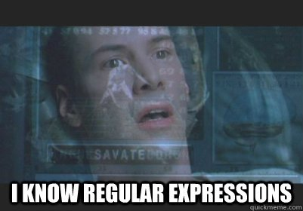
3. Regular Expressions
Example 3:
What will the regular expression ^[Oo]rgani.e\w+$ match?
And ^[Oo]rgani.e\w?\b
https://www.browserling.com/tools/text-from-regex
Solution
1) Any other string that ends a line, begins with a letter o in lower or capital case, proceeds with rgani, has any character in the 7th position, follows with letter e and at
least one or more characters from the range [A-Za-z0-9].
2)Any other string that starts a line, begins with a letter o in lower or capital case, proceeds with rgani, has any character in the 7th position, follows with letter e, and ends with zero or one characters from the range [A-Za-z0-9].

Slide 35

3. Regular Expressions
Example 4:
Let’s complicate things a little
\b[Oo]rgani.e\b|\b[Oo]rgani.e\w{1}\b?
https://www.browserling.com/tools/text-from-regex
Solution
Any other string that begins with a letter o in lower or capital case after a word boundary, proceeds with rgani,
has any character in the 7th position, and end with letter e,
OR
any other string that begins with a letter o in lower or capital case after a word boundary, proceeds with rgani, has any character in the 7th position, follows with letter e,
and ends with a single character from the range [A-Za-z0-9].

Slide 36

3. Regular Expressions
Now it is your turn!!
Exercise 1:
What will the regular expression Fr[ea]nc[eh] match?
Do you think is a well-written expression?
And this one instead Fr[ea]nc[eh]$?
https://www.browserling.com/tools/text-from-regex
Solution
Note that the way this regular expression is constructed, it will match misspellings such as Franch and Frence. Lacking an “anchor” such as ^ or \b, this will also find strings where there are characters to either side of the regular expression, such as in French, France's, French-fried.
Match the pattern only when it appears at the end of a line. It will also find strings with other characters coming before the pattern, for example, in French or faux-French.

Slide 37

3. Regular Expressions
Exercise 2:
How do you match the whole words colour and color (case insensitive)?
https://www.browserling.com/tools/text-from-regex
Solution
\b[Cc]olou?r\b|\bCOLOU?R\b
you should only come across the case insensitive variations colour, color, Colour, Color, COLOUR, and COLOR (rather than, say, coLour). So based on what we know, the logical regular expression is \b[Cc]olou?r\b|\bCOLOU?R\b. An alternative more elegant option we’ve not discussed is to take advantage of the / delimiters and add an ‘ignore case’ flag: so /colou?r/i will match all case insensitive variants of colour and color.

Slide 38
3. Regular Expressions
Exercise 3:
How would you find the whole word headrest and or head rest but not head rest (that is, with two spaces between head and rest?
https://www.browserling.com/tools/text-from-regex
Solution
\bhead ?rest\b
Note that although \bhead\s?rest\b does work, it will also match zero or one tabs or newline characters between head and rest. So again, although in most real world cases it will be fine, it isn’t strictly correct.

Slide 39
3. Regular Expressions
Exercise 4:
How would you match publication formats such as British Library : London, 2015 and Manchester University Press: Manchester, 1999?
https://www.browserling.com/tools/text-from-regex
Solution
.* ?: .*, \d{4}
Without word boundaries you will find that this matches any text you put before British or Manchester. Nevertheless, the regular expression does a good job on the first look up and may be need to be refined on a second, depending on your data.

Slide 40

4. Matching and Extracting
Questions
How can you use regular expressions to match and extract strings?
Objectives
Use regular expressions to match words, email addresses, and phone numbers.
Use regular expressions to extract substrings from strings (e.g. addresses).

Slide 41
4. Matching and Extracting
On your browser open: https://regex101.com/
Open the swcCoC.md file, copy it, and paste it into the test string box.
For a quick test to see if it’s working, type the string community into the regular expression box.
If you look in the box on the right of the screen, you see that the expression matches six instances of the string ‘community’ (the instances are also highlighted within the text).

Slide 42

4. Matching and Extracting
1) Taking spaces into consideration
Type community You get three matches. Why not six?
Solution
The string ‘community-led’ matches the first search, but drops out of this result because the space does not match the character -.

Slide 43

4. Matching and Extracting
2) Taking any character into consideration
If you want to match ‘community-led’ by adding another regex character to the expression community, what would it be?
Solution
It would be the .

Slide 44

4. Matching and Extracting
3) Exploring effect of expressions matching different words
Change the expression to communi and you get 13 full matches of several words. Why?
Solution
Because the string ‘communi’ is present in all of those words, including communication and community. Because the expression does not have a word boundary, this expression would also match incommunicado, were it present in this text. If you want to test this, type incommunicado into the text somewhere and see if it is found.

Slide 45
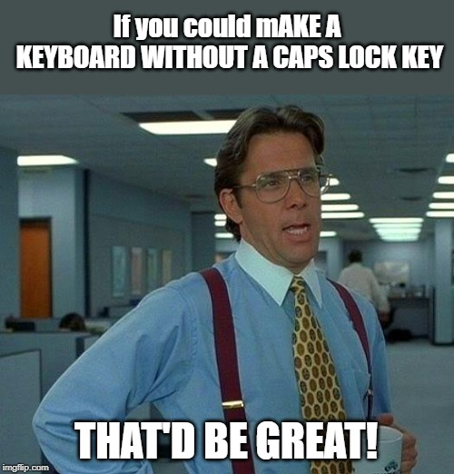
4. Matching and Extracting
4) Taking capitalization into consideration
Type the expression [Cc]ommuni
You get 14 matches. Why?
Solution
The word Community is present in the text with a capital C and with a lowercase c 14 times.

Slide 46

4. Matching and Extracting
5) Regex characters that indicate location
Type the expression ^[Cc]ommuni
You get no matches. Why?
Solution
There is no matching string present at the start of a line. Look at the text and replace the string after the ^ with something that matches a word at the start of a line. Does it find a match?

Slide 47

4. Matching and Extracting
6) Finding plurals
Find all of the words starting with Comm or comm that are plural.
Solution
[Cc]omm\w+s\b
[Cc] finds capital and lowercase c
omm is straightforward character matches
\w+ matches the preceding element (a word character) one or more times
s is a straightforward character match
\b ensures the ‘s’ is located at the end of the word.

Slide 48
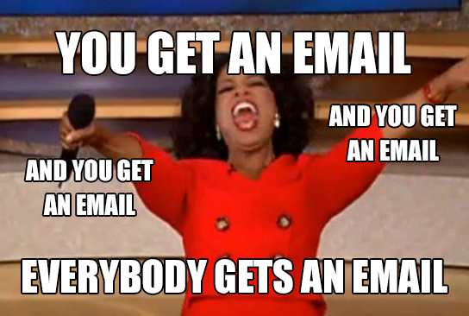
4. Matching and Extracting
Finding email addresses using regex101.com
What character do you know is held in common with all email addresses?
The string before the “@” could contain any kind of word character, special character or digit in any combination and length. How would you express this in regex? Hint: often addresses will have a dash (-) or dot (.) in them, and neither of these are included in the word character expression (\w). How do you capture this in the expression?
Solution
[\w.-]+@
\w matches any word character (including digits and underscore)
. matches a literal period (when used in between square brackets, . doesn’t mean “any character”, it literally means “.”)
- matches a dash
[] the brackets enclose the boolean string that ‘OR’ the word characters, dot, and dash.
+ matches any word character OR digit OR character OR - repeated 1 or more times

Slide 49
4. Matching and Extracting
Finding email addresses using regex101.com
Finish the expression
The string after the “@” could contain any kind of word character, special character or digit in any combination and length as well as the dash. In addition, we know that it will end with two or three characters after a period (.) What expression would capture this.
Hint: the . is also a regex expression, so you’ll have to use the escape \ to express a literal period.
Solution
[\w.-]+\.\w {2,3}
\. matches the literal period (‘.’) not the regex expression .
\w matches any word (including digits and underscore)
{2,3} limits the number of word characters and/or digits to a two or three-character string.
[] the brackets enclose the boolean string that ‘OR’ the digits, word characters, characters and dash.
+ matches any word character OR digit OR character OR - repeated 1 or more times

Slide 50
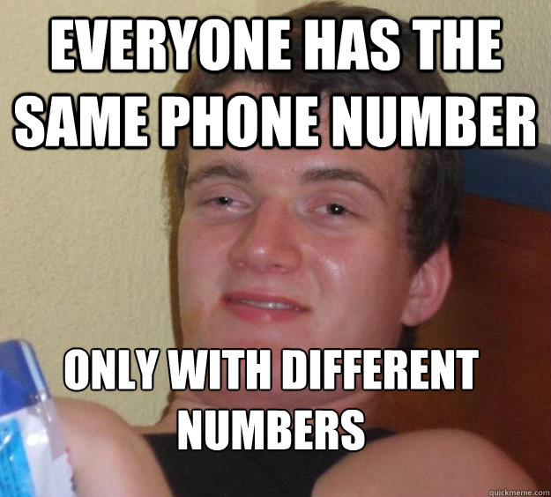
4. Matching and Extracting
Does this Code of Conduct contain a phone number?
What to consider:
It may or may not have a country code, perhaps starting with a “+”.
It will have an area code, potentially enclosed in parentheses.
It may have the sections all separated with a “-“.
Start with what we know, which is the most basic format of a phone number: three digits, a dash, and four digits. How would we write a regex expression that matches this?
Solution
\d{3}-\d{4}
\d matches digits
{3} matches 3 digits
- matches the character ‘-‘
\d matches any digit
{4} matches 4 digits.
This expression should find three matches in the document.

Slide 51
4. Matching and Extracting
How would we expand the expression to include an area code (three digits and a dash)?
How would we expand the expression to include a phone number with an area code in parenthesis, separated from the phone number, with or without a space.
Solution
\(\d{3}\) ?\d{3}-\d{4}
\( escape character with the parenthesis as straightforward character match
\d matches digits
{3} matches 3 digits
\) escape character with the parenthesis as a straightforward character match
? matches zero or one spaces
This expression should find two matches in the document.
Solution
\d{3}-\d{3}-\d{4}
\d matches digits
{3} matches 3 digits
- matches the character ‘-‘
\d matches any digit
{4} matches 4 digits.
This expression should find one match in the document

Slide 52
4. Matching and Extracting
Match a phone number containing a country code.
Country codes are preceded by a “+” and can have up to three digits. We also have to consider that there may or may not be a space between the country code and anything appearing next.
Solution
\+\d{1,3} ?\(\d{3}\)\s?\d{3}-\d{4}
\+ escape character with the plus sign as straightforward character match
\d matches digits
{1,3} matches 1 to 3 digits
? matches zero or one spaces
This expression should find one match in the document.

Slide 53
4. Matching and Extracting
Using regular expressions when working with files and directories
One of the reasons we stress the value of consistent and predictable directory and filenaming conventions is that working in this way enables you to use the computer to select files based on the characteristics of their file names.
Or if you have ‘journal’ somewhere in a filename when you have data about journals, you can use the computer to select just those files. Equally, using plain text formats means that you can go further and select files or elements of files based on characteristics of the data within those files. More on the topic here:
File Naming & Formatting
For example, if you have a bunch of files where the first four digits are the year and you only want to do something with files from ‘2017’, then you can.

Slide 54
4. Matching and Extracting
Extracting a substring in Google Sheets using regex
Extracting a substring in Google Sheets using regex
Export and unzip the 2017 Public Library Survey (originially from the IMLS data site) as a CSV file.
Upload the CSV file to Google Sheets and open as a Google Sheet if it doesn’t do this by default.
Look in the ADDRESS column and notice that the values contain the latitude and longitude in parenthesis after the library address.
Construct a regular expression to match and extract the latitude and longitude into a new column named ‘latlong’. HINT: Look up the function REGEXEXTRACT in Google Sheets. That function expects the first argument to be a string (a cell in ADDRESS column) and a quoted regular expression in the second.
Solution
Inside the cell you can use the below to extract the Latitude and Longitude into a single cell. You can then copy the formula down to the end of the column.
=REGEXEXTRACT(G2,"\d+\.\d+, -?\d+\.\d+")
Here we are using \d+ for a one or more digit match followed by a period \.. Note we had to escape the period using \. After the period we look for one or more digits \d+ again followed by a literal comma ,. We then have a literal space match followed by an optional dash - (there are few 0.0 Latitude/Longitudes that are probably errors, but we’d want to retain so we can deal with them). We then repeat our \d+\.\d+ we used for the Latitude match.

Slide 55

4. Matching and Extracting
Key Points
Regular expressions are useful for searching and cleaning data.
Test regular expressions interactively with regex101.com or RegExr.com, and visualise them with regexper.com.
Test yourself with RegexCrossword.com/ or via the quiz and excercises in this lesson.

Slide 56
5. Additional Exercises
How would you find a string that ends with four letters preceded by at least one zero?
Solution
0+[A-Za-z]{4}\b

Slide 57
5. Additional Exercises
Matching digits
How do you match any four-digit string anywhere?
Solution
\d{4}
Note: this will also match four-digit strings within longer strings of numbers and letters.

Slide 58
5. Additional Exercises
Matching dates
How would you match the date format dd-MM-yyyy?
Solution
\b\d{2}-\d{2}-\d{4}\b
Depending on your data, you may choose to remove the word bounding.

Slide 59
5. Additional Exercises
Matching multiple date formats
How would you match the date format dd-MM-yyyy or dd-MM-yy at the end of a line only?
Solution
\d{2}-\d{2}-\d{2,4}$
Note this will also find strings such as 31-01-198 at the end of a line, so you may wish to check your data and revise the expression to exclude false positives. Depending on your data, you may choose to add word bounding at the start of the expression.

Slide 60

Thanks for your attention!, Any question?

